Slide 1
RUNNING NINJA
Made and presented by Le Thanh Son

Slide 2
Slidehood.com
OVERVIEW
Brief info about game development
Gameplay and Objectives
Features
Future Ideas
Useful stuff in development

Slide 3

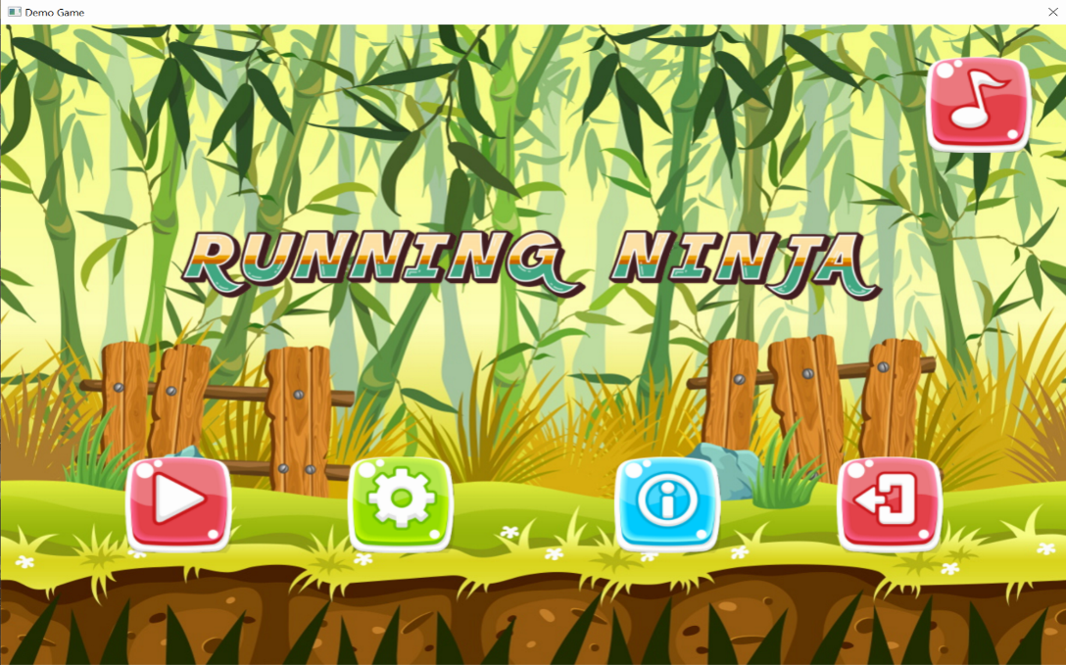
About this game development
Slidehood.com
Windows
2 weeks
Microsoft Visual Studio Express 2015

Slide 4
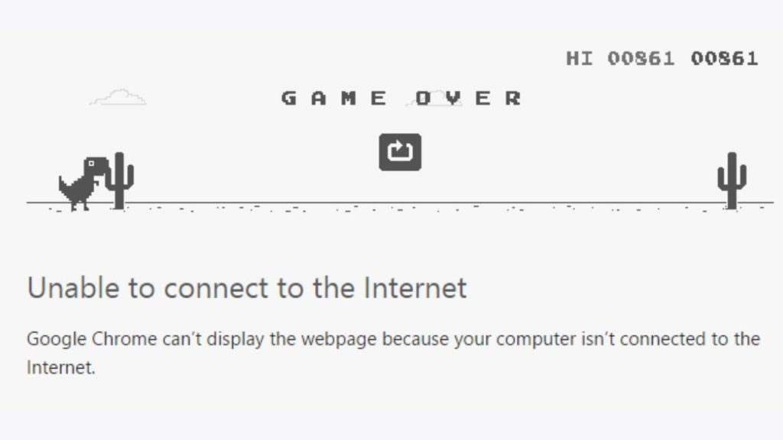
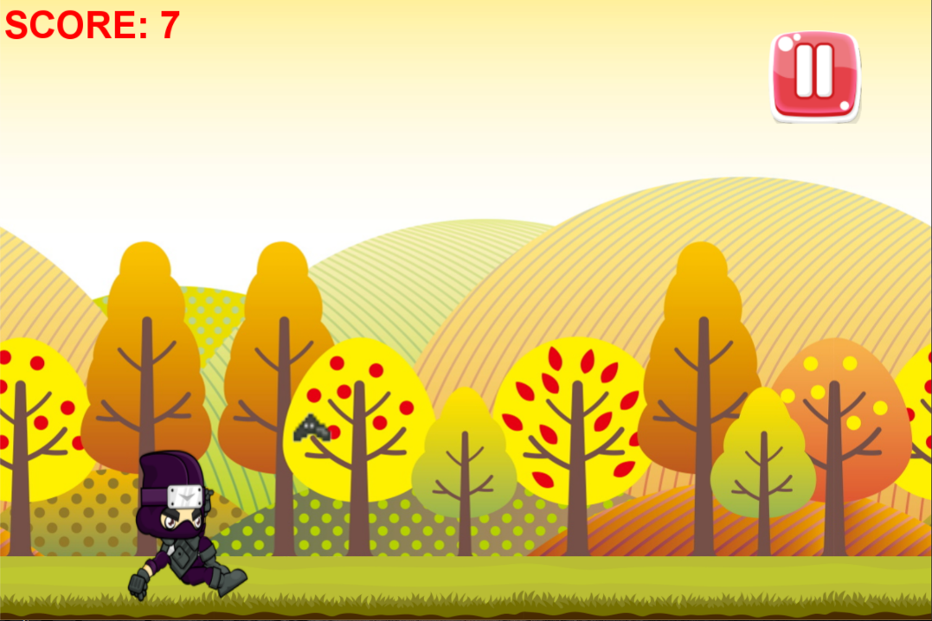
Gameplay
Slidehood.com
+ Inspired by Dino Disconnect Game.
+ Dodge and pass obstacles.
+ Pass 1 obstacle = 1 point.
+ Difficulty increases over time.
+ No limit.

Slide 5
Objectives
Slidehood.com
Never give up and score a lot of points.
Become satisfied as you get better and better at the game.
And the most important:
HAVE FUN !!

Slide 6
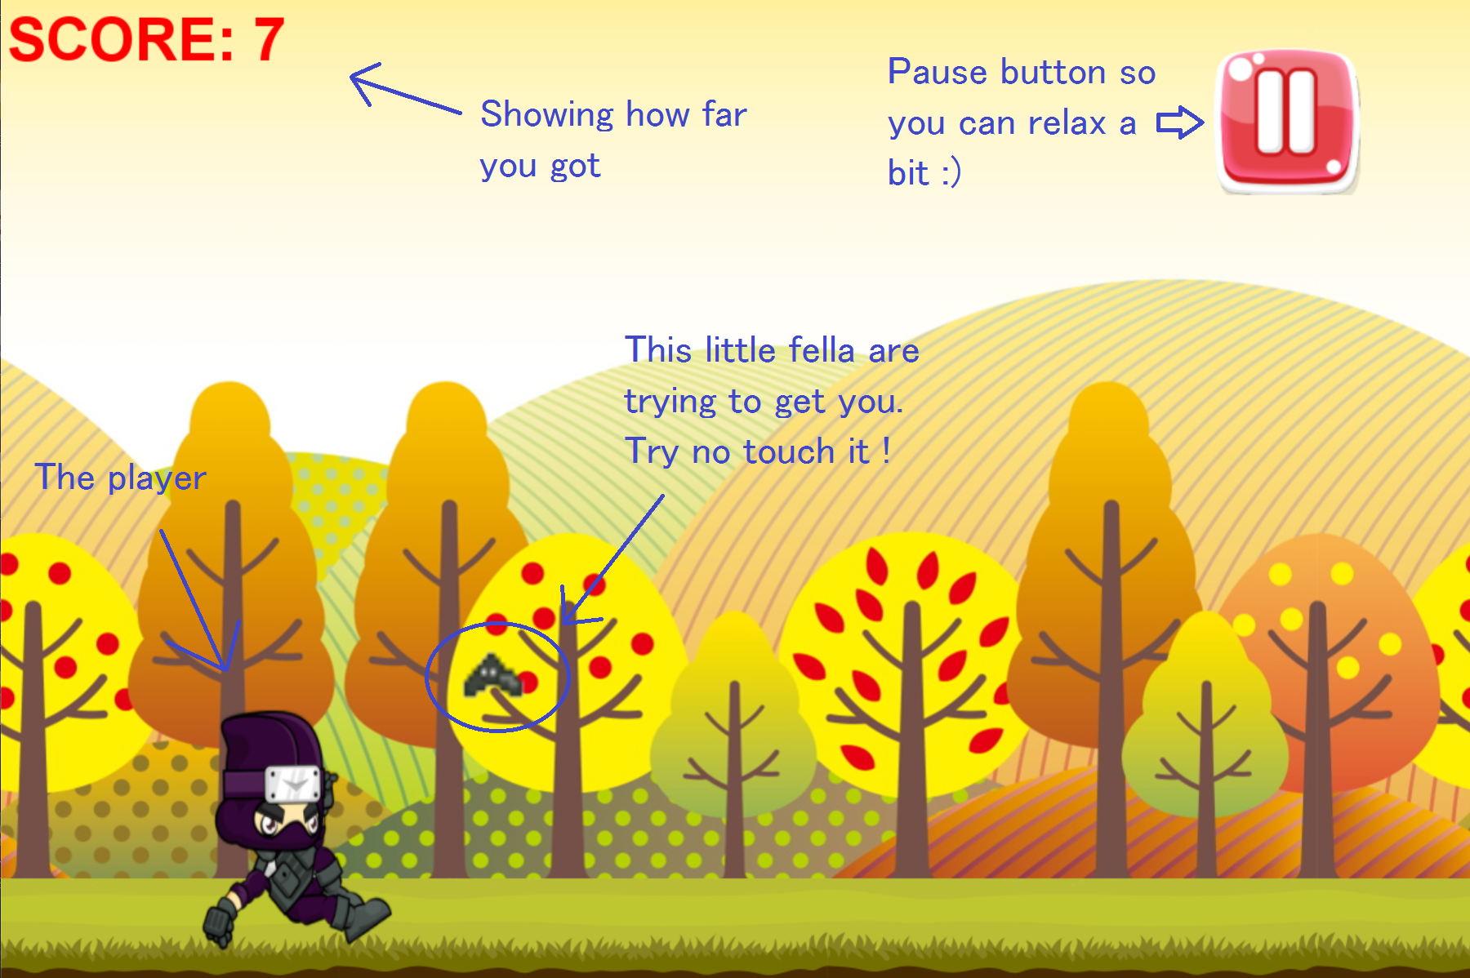

Slide 7
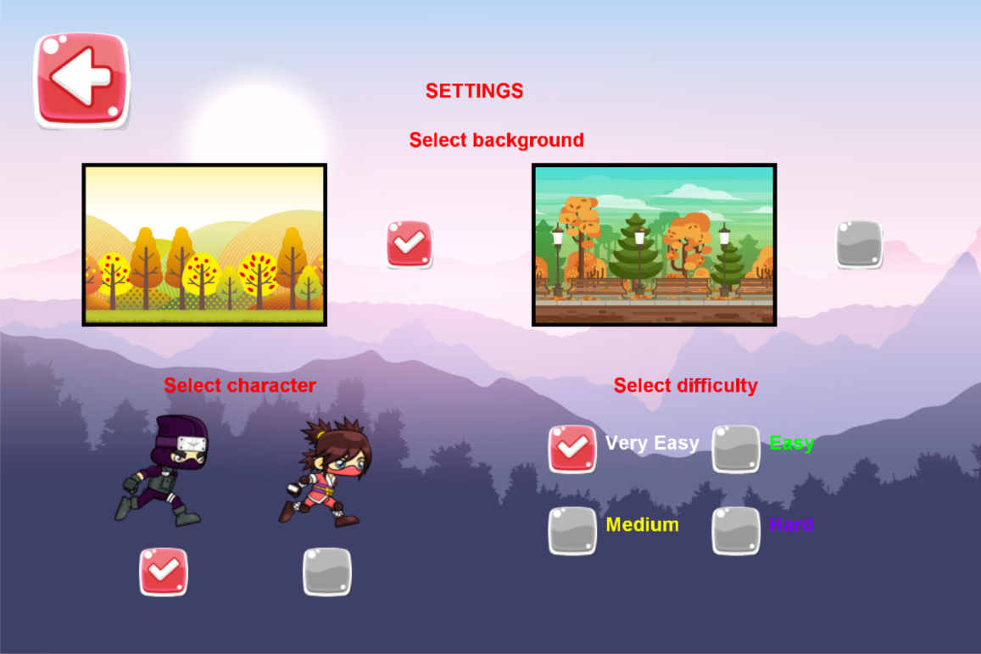
Slidehood.com
Customize your game
+ Change background
+ Switch character
+ Increase difficulty
+ Turn on/off BGM

Slide 8
Slidehood.com
Future development ?
More challenging obstacles
Improve game performance
Show your high score with friends
Provide more features/services for users
Add unlockable items (backgrounds,
characters, obstacles ...)
Release on many platforms

Slide 9





Some helpful tools and sources in the game development
Slidehood.com

Slide 10
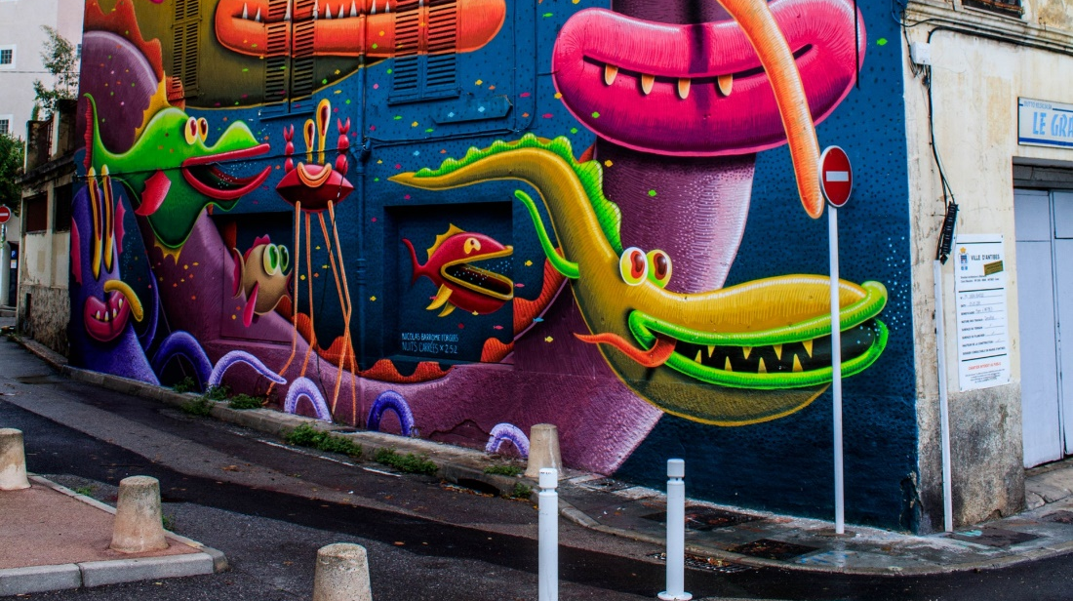
THANKS FOR LISTENING
Slidehood.com

